Slide 1
Worklet –Visual Computing
Date: 07/06/22 Team Members: Hemalatha T(RA2011003010107)
Prakash Y(RA2011003010044)
Praveen S(RA2011003010116)
Rakin Roula(RA2011003010131)

Slide 2
TITLE OF THE WORKLET
ID Card and Helmet Verification at The Entrance Gate Using Computer Vision

Slide 3
Problem Statement
Visual examination of Road Safety and in-time reminder to the failure of wearing a helmet is of particular importance to avoid accidents. Video monitoring systems provide a large amount of unstructured image data on-site for this purpose, however, requiring a computer vision-based automatic solution for real-time detection.
Also, wearing of ID cards are extremely important when a student enters the College premises. Although a growing body of literature has developed many deep learning-based models to detect helmet for the traffic surveillance aspect, an appropriate solution for the ID is less discussed in view of the complex scene on the College Campus. In this regard, we develop a deep learning-based method for the real-time detection of a helmet and ID card at the College gate.

Slide 4
Dataset Description
We have collected the data set from www.Kaggle.com and google images and trained the images using Google Collaboratory Service with GUI. a dataset of 2000 images containing various helmets and ID cards are built and divided into three parts to train and test the model. The TensorFlow framework is chosen to train the model. After the training and testing process, the model is to be imported in the OpenCV python code. The presented method offers a solution to detect the helmets and ID cards and improve the safety management and rules and regulations of a College Campus.

Slide 5
Algorithm to be used
The presented method uses the SSD-MobileNet algorithm that is based on convolutional neural networks. A dataset containing 1000 images of helmets and ID cards collected from two sources, i.e., manual capture from the video monitoring system at the workplace and open images obtained using web crawler technology, is established and released to the public.

Slide 6
Novel Idea in the Proposal
The file proposed a method for detecting the helmets and ID cards based on convolutional neural networks. The model uses the SSD-MobileNet algorithm to detect helmets and ID cards. Then, a dataset of 2000 images containing various helmets and ID cards are built and divided into three parts to train and test the model. The TensorFlow framework is chosen to train the model. After the training and testing process, the model is to be imported in the OpenCV python code. The presented method offers a solution to detect the helmets and ID cards and improve the safety management and rules and regulations of a College Campus.

Slide 7
Hardware and Software Requirement
A convolutional neural network (CNN) is a multilayer neural network. It is a deep learning method designed for image recognition and classification tasks. It can solve the problems of too many parameters and difficult training of the deep neural networks and can get better classification effects. The structure of most CNNs consists of input layer-convolutional layer (Conv layer)-activation function-pooling layer-fully connected layer (FC layer). The main characteristics of CNNs are local connectivity and parameter sharing in order to reduce the number of parameters and increase the efficiency of detection.

Slide 8
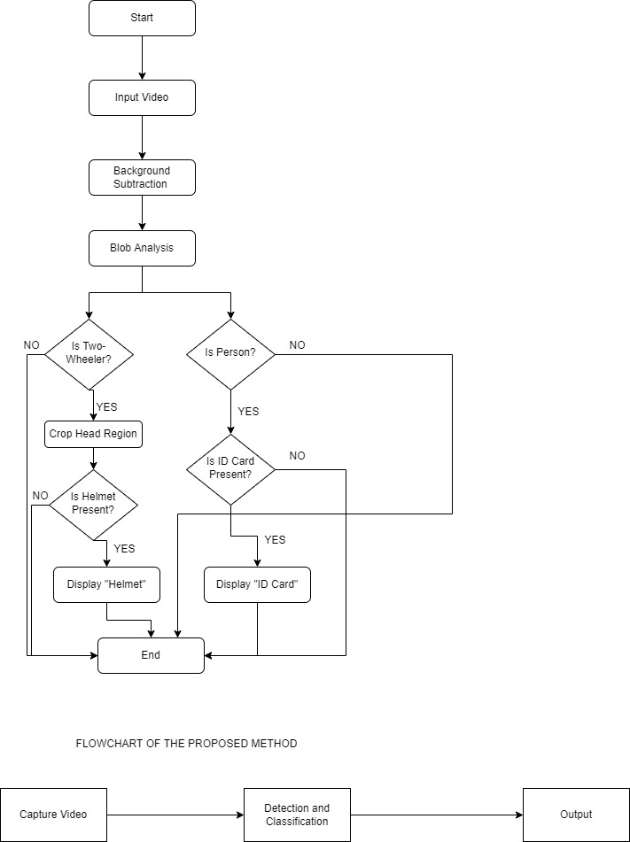
Proposed Architecture

Slide 9
Workflow of Architecture
The data required for the experiment were collected by the author. Since there are few object detection applications of helmets and ID cards using deep learning and there is no off-the-shelf ID card dataset available, part of the experimental data was collected using web crawler technology, making full use of network resources. By using several keywords, such as “people wearing helmets” and “people wearing ID cards” python language is used to crawl relevant pictures on the Internet. However, the quality of the crawled images varies greatly. There are problems that there is an only background and no objects in some images, the size of the safety helmet is small, and the shape is blurred.

Slide 10
Therefore, images were also collected manually besides web crawling. 2000 images were collected in total. The images that did not contain helmets and ID cards, duplicate images, and the images that are not in the RGB three-channel format were eliminated and images were left, forming the safety helmet detection dataset. Some images in the dataset are shown. To increase the detection effect of the safety helmet detection model in detecting helmets and ID cards with different directions and brightness in images, the image dataset was pre-processed such as rotation, cutting, and zooming.

Slide 11
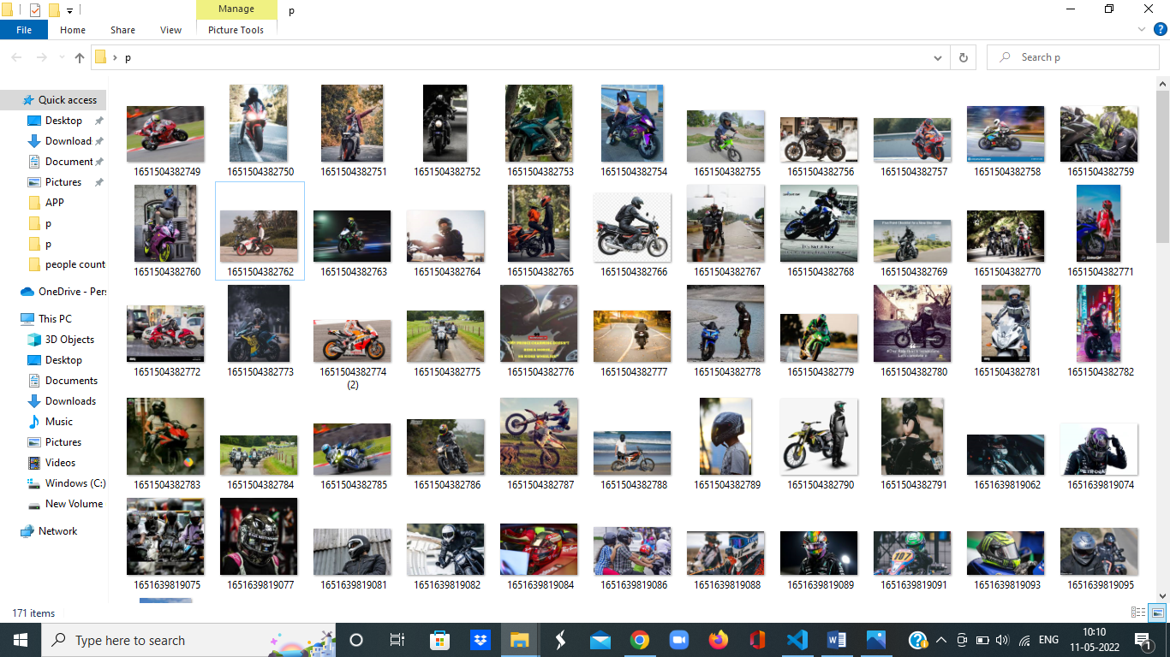
HELMETS

Slide 12
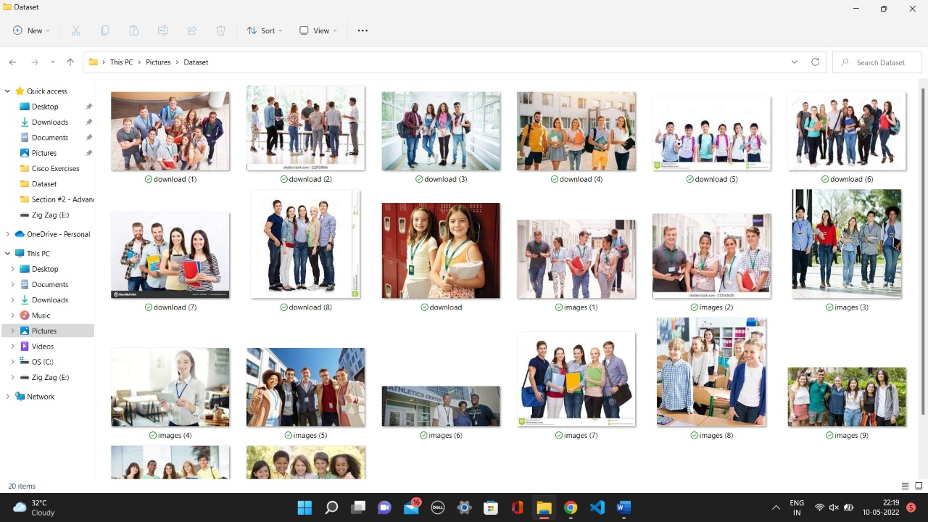
ID CARDS

Slide 13
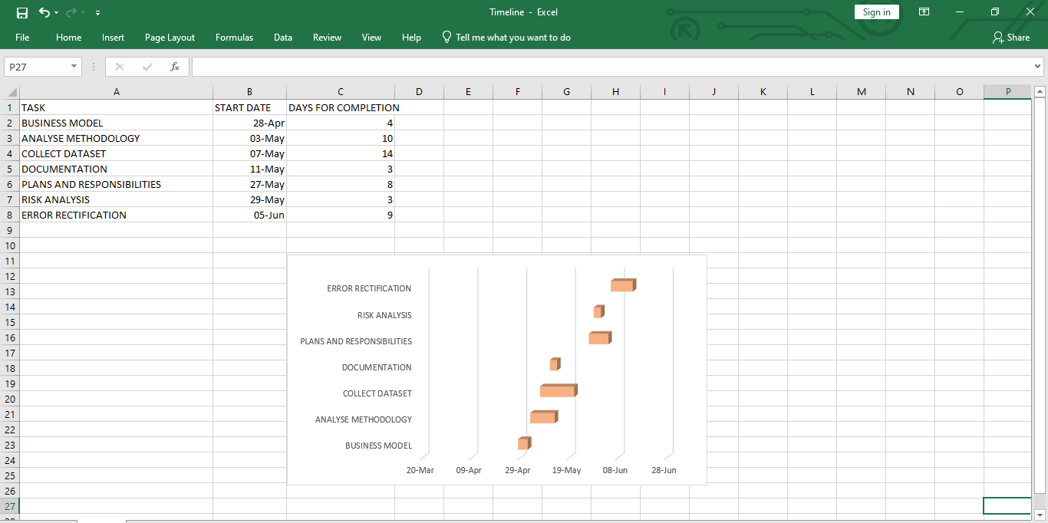
TIMELINE (Gantt chart )

